Slide 1
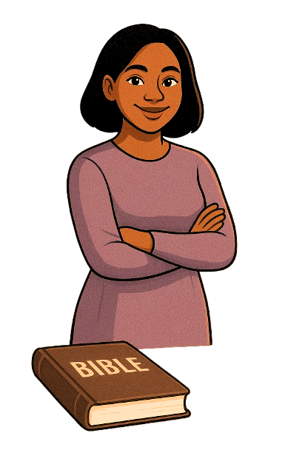
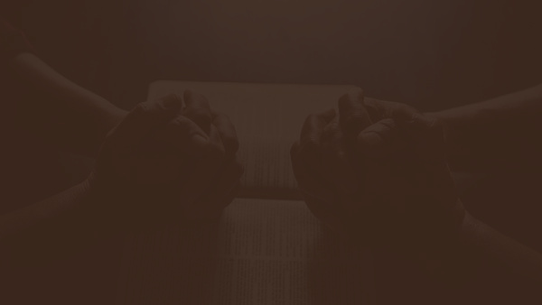



FAITH
EMPOWERED BY
ESTHER 4:14
NATIONAL WOMEN’S WEEK CELEBRATION ‘25
By: Marian Yakah

Slide 2

What does it mean to be empowered?
Empowerment can involve gaining the knowledge, skills and resources needed to succeed, as well as feeling confident and secure in one’s abilities.

Slide 3
What does it mean to be empowered?
The Merriam-Webster dictionary defines empowerment or to be empowered as the granting of the power, right or authority to perform various acts or duties.
Which suggests to me that there are some acts, duties, or things you need power or authority to be able to carry out.

Slide 4

Bible Verse
Now faith is confidence in what we hope for and assurance about what we do not see
Hebrews 11:1 (NIV)

Slide 5
Bible Verse
For with God nothing will be impossible
Luke 1:37 (NIV)

Slide 6

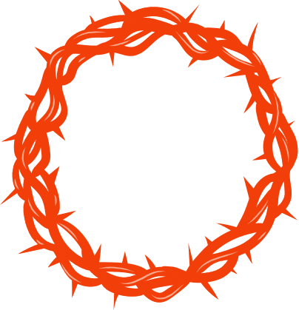
How then can you have faith?
1
Accepting the Lord as your Personal Saviour

Slide 7
Bible Verse
And without faith it is impossible to please him, for whoever would draw near to God must believe that he exists and that he rewards those who seek him.
Hebrews 11:6 (NIV)

Slide 8


How then can you have faith?
2
Staying in the word / Abiding in the word

Slide 9
Bible Verse
So then faith cometh by hearing and hearing the word of God
Romans 10:17 (NIV)

Slide 10

How then can you have faith?
3
Not forsaking the gathering of the saints

Slide 11
Bible Verse
...not giving up meeting together, as some are in the habit of doing, but encouraging one another—and all the more as you see the Day approaching.
Romans 10:17 (NIV)

Slide 12


HOW DOES FAITH EMPOWER US?
1
Faith is currency

Slide 13


HOW DOES FAITH EMPOWER US?
2
Faith helps us get through life’s seasons.

Slide 14
Bible Verse
In all circumstances take up the shield of faith, with which you can extinguish all the flaming darts of the evil one
Ephesians 6:16 (NIV)

Slide 15
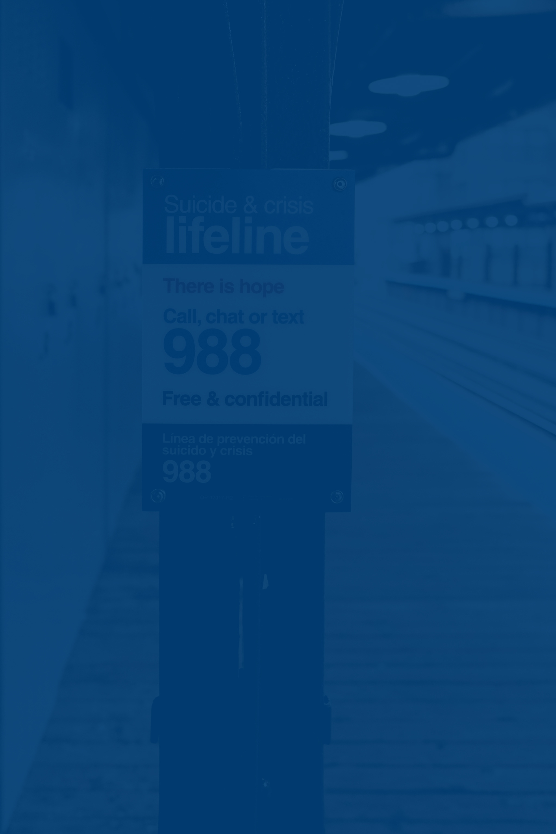

HOW DOES FAITH EMPOWER US?
3
Faith is central/ critical to the lifeline of our Christian Walk/ Christian journey

Slide 16
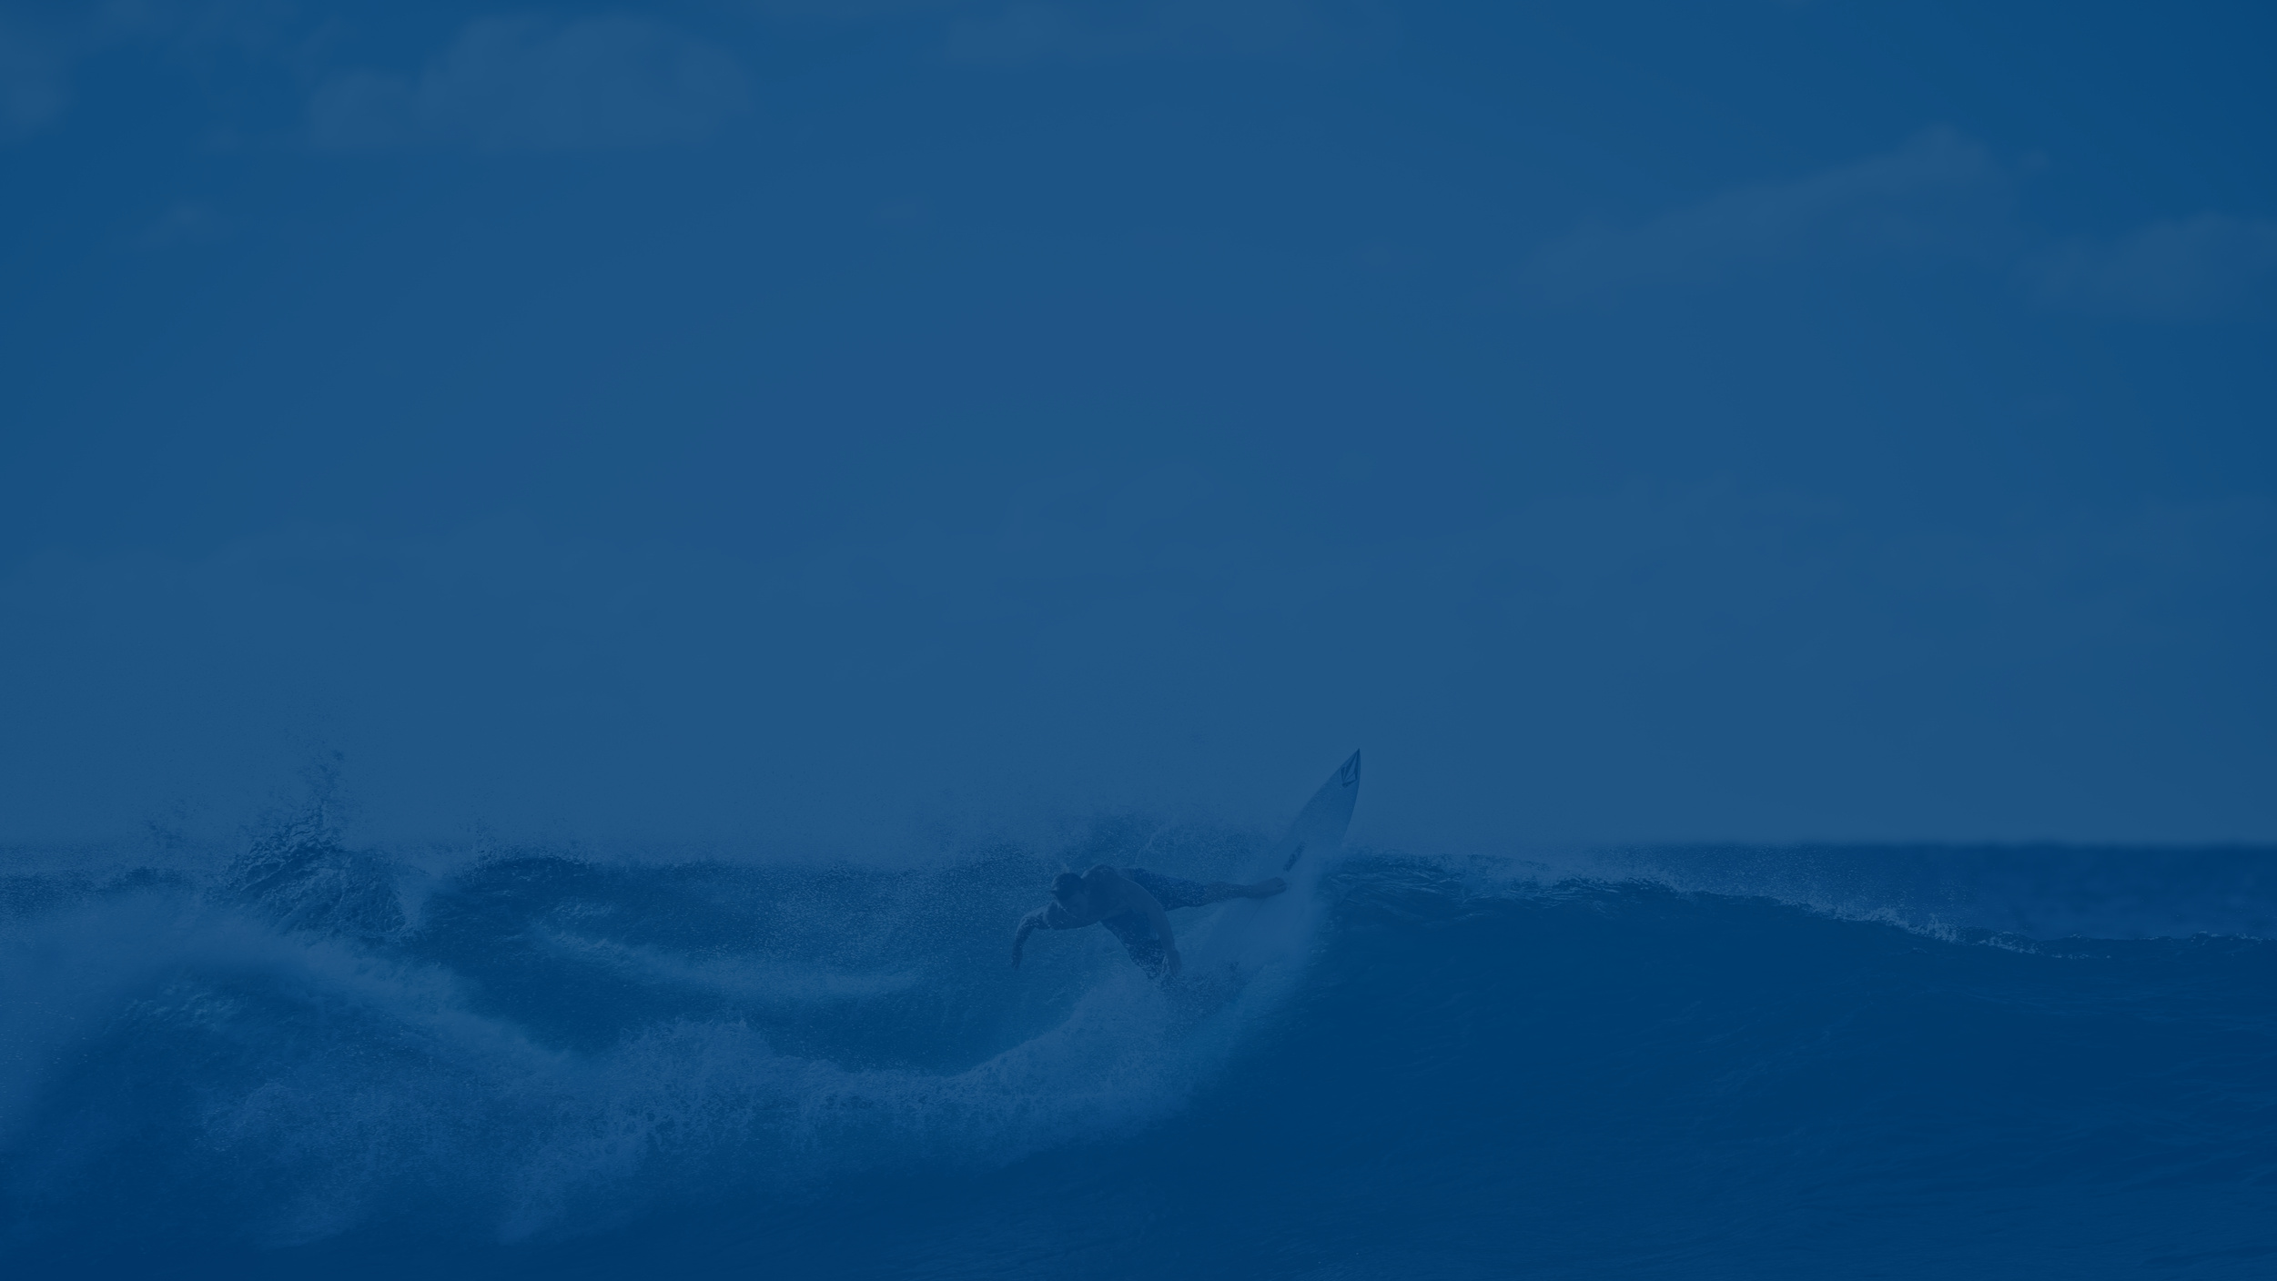

CONCLUSION
What are you being called to have faith on?
What are you being called to surrender your trust/ faith to God on but have held on to so tightly?

Slide 17

GOD BLESS YOU!

